Slide 1

Optiver- Trading at the close
Professor : Chaojie Wang
Venkata Rachana Yekkirala
NH62619
This Photo by Unknown Author is licensed under CC BY-ND

Slide 2
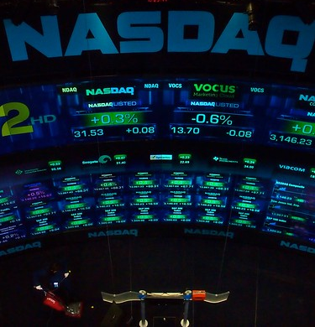
Introduction
The project involves developing a predictive model to forecast the closing price movements of stocks listed on the Nasdaq during the highly violate final minutes of trading. Information from the auction can be used to adjust prices, assess supply and demand dynamics, and identify trading opportunities.
This Photo by Unknown Author is licensed under CC BY-SA

Slide 3
Objectives
Develop predictive models for forecasting closing price movements of Nasdaq listed stocks.
Utilize data from both the order book and the closing auction to adjust prices and assess supply-demand dynamics.
Enhance market efficiency and accessibility during the critical final ten minutes of trading.
Provide firsthand experience in handling real-world data science challenges faced by market participants.

Slide 4
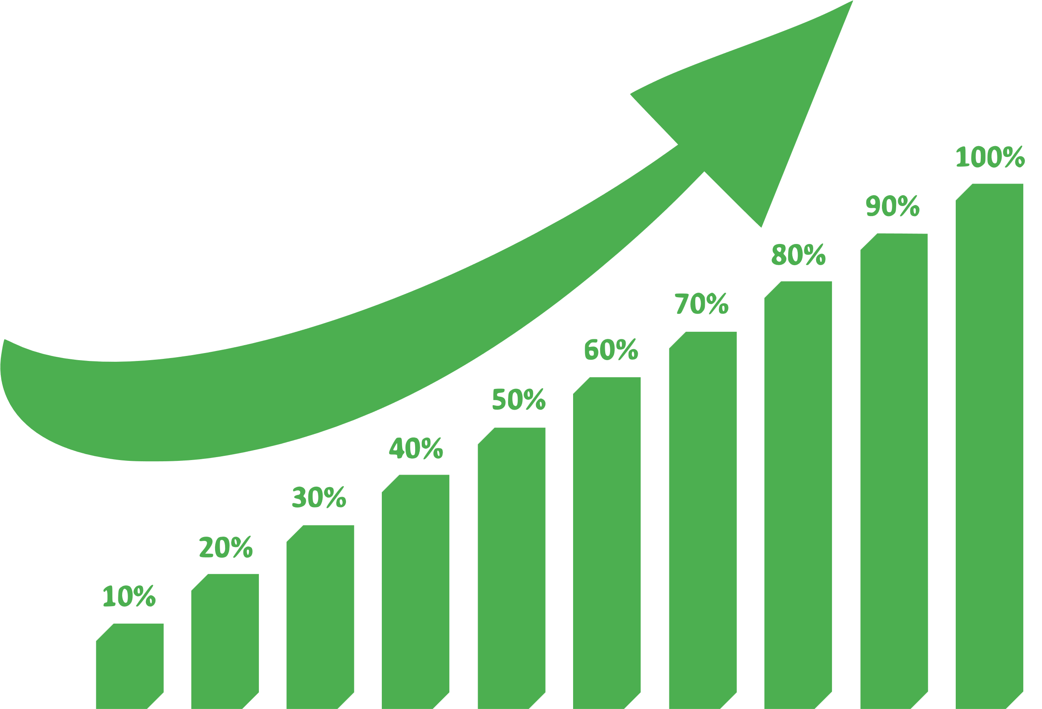
Data Source
The dataset is taken from Kaggle Competitions.
The size of the data is 52,37,980 rows and 17 columns.

Slide 5
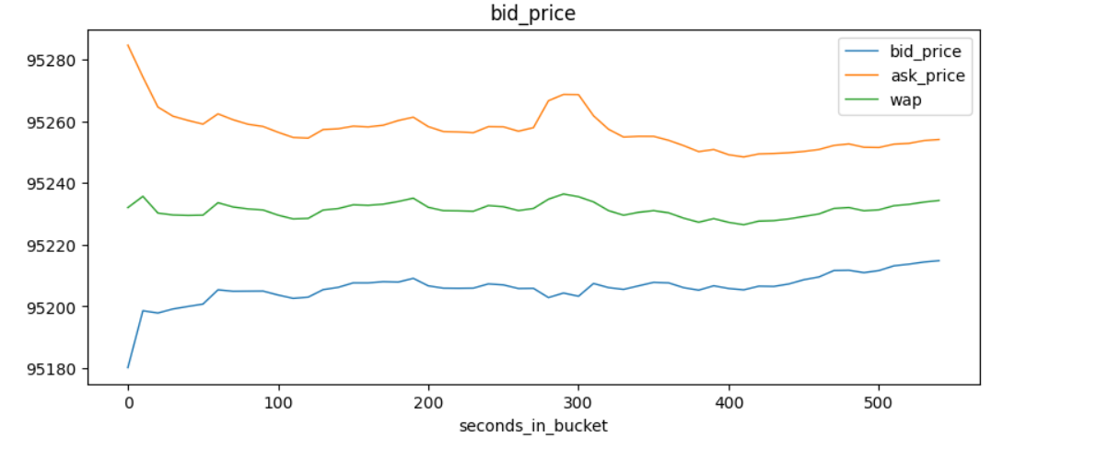
EDA

Slide 6
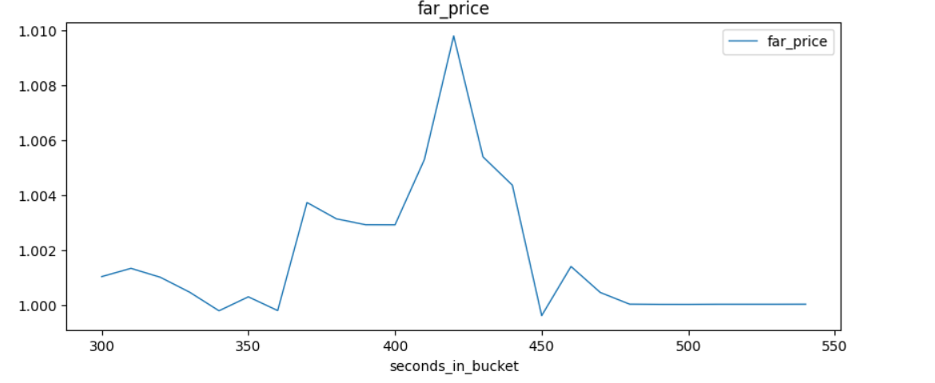
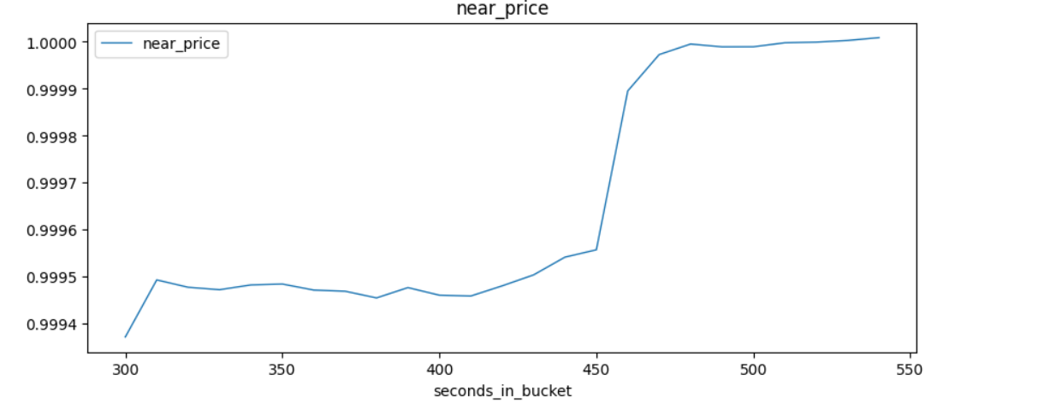

Slide 7
Missing values
There are a couple of Null values in the data and in order to handle them I have chosen the Imputation method.
Near and Far price Nan values are filled using Linear regression method.
Other features null values are filles using median method.
And the values for target column are dropped.

Slide 8
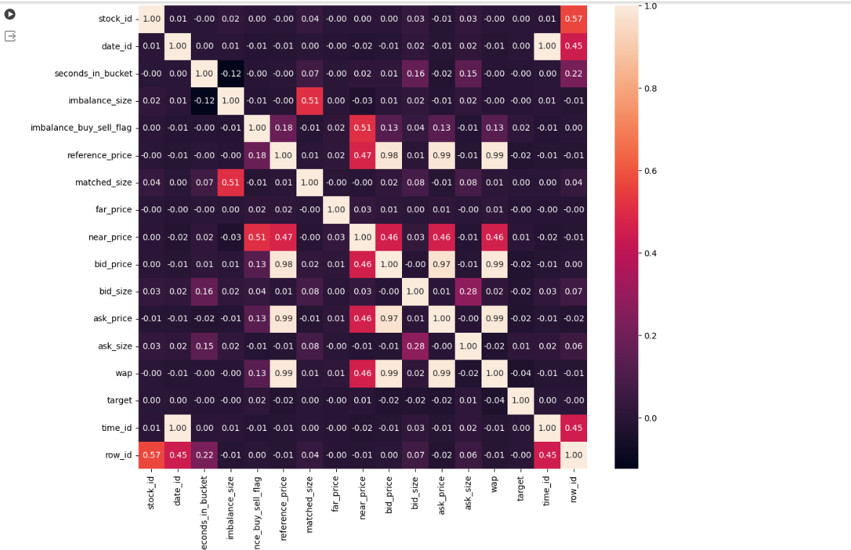
Correlation matrix

Slide 9
Machine learning models
I have chosen three gradient boost methods LightGBM, CatBoost and XGBoost.
I have chosen them for their proven ability to handle large and complex data sets efficiently, their robustness to overfitting and their effectiveness in modeling the non-linear dynamics typical of financial markets.
The evaluation metrics are MSE and R2 value.

Slide 10
Light gbm
The light gbm have shown a mse of 86.55 and R2 score of 0.028
After Hyper Param tuning and selecting the best parameters for the model and retraining it have shown good results.
The mse value post tuning is 84.91 and R2 value is 0.04

Slide 11
Cat boost gbm
The mse value is 85.97 and R2 value is 0.034
Post hyper param tuning and selecting best parameters and re tuning the model the values model have shown good results.
The mse value came around 82.101 and R2 value around 0.07.

Slide 12
Xgboost gbm
The mse value is 86.96 and R2 value is 0.03
Post hyper param tuning and choosing the best parameters and retraining the model did not shown a significant change in the result.
The mse value post tuning is 85.477 and R2 value 0.034.

Slide 13

Appropriate Model
After clear evaluation of results given by the models. I have chosen cat boost as it was very fast in training the model and also have shown good results.
The mse value has not shown most significant difference but it was lower than the remaining models and r2 value compared was very good and appropriate.
Using Cat Boost I have trained the test data and predicted the closing values.

Slide 14


